Slide 1

The American Dream
Christopher Ferrin

Slide 2
Figures who have lived the American Dream

Slide 3
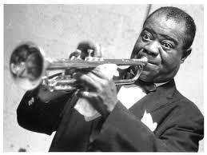
Louis Armstrong

Slide 4
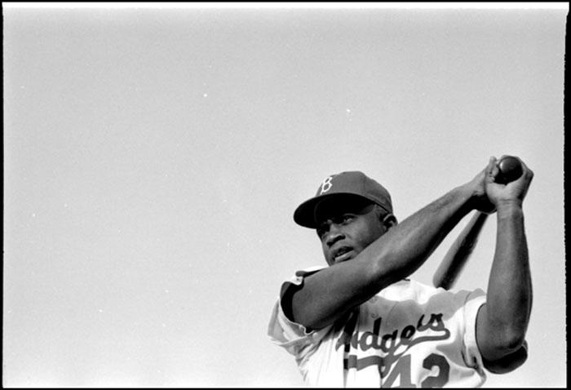
Jackie Robinson

Slide 5
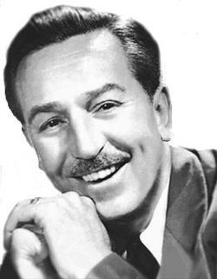
Walt Disney

Slide 6
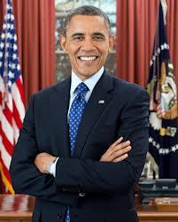
Barack Obama

Slide 7
How have I lived the American Dream so far

Slide 8
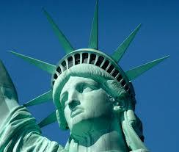
Having Freedom

Slide 9
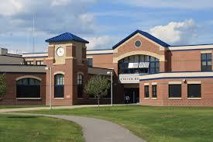
Obtaining Education

Slide 10
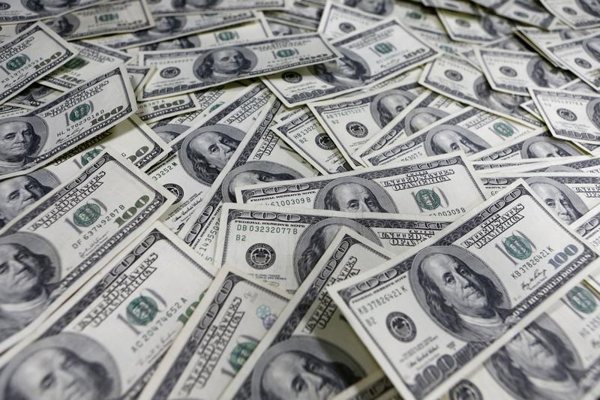
Earning money through hard work

Slide 11



Participate in activities I enjoy

Slide 12
“All of our dreams can come true, if we have the courage to pursue them.”
-Walt Disney

Slide 13
Is the American Dream real?
Yes

